Slide 1


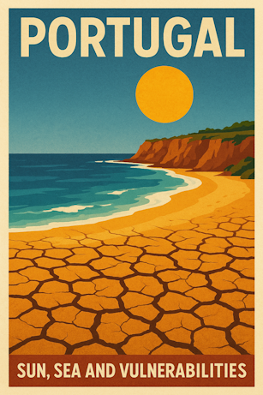
Porto Business School
19/05/2025

Slide 2
PBS
OSINT
PORTUGAL, SUN, SEA AND VULNERABILITIES
Agenda
Common Attack Vectors
Vulnerability
Portuguese landscape
Page 2

Slide 3

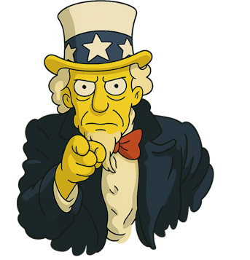
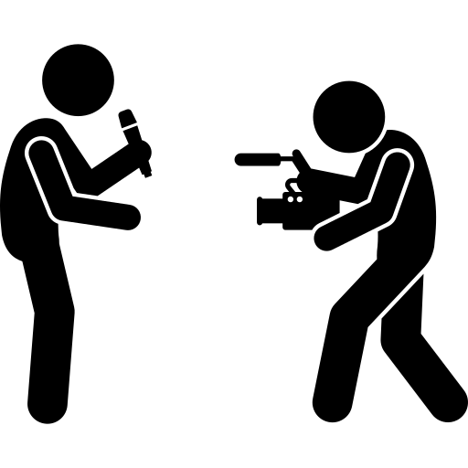
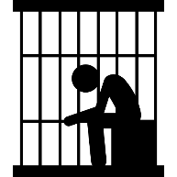
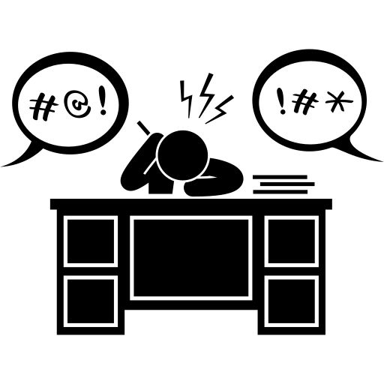
PBS
OSINT
PORTUGAL, SUN, SEA AND VULNERABILITIES
Disclaimer & Legal Considerations
Presentation is solely for educational and awareness purposes.
Live content may be unpredictable and potentially inappropriate for some viewers.
Users must check the legality of OSINT tools and methods in their country.
This presentation is not related to my work or employer.
images: Flaticon.com
Page 3

Slide 4

PBS
OSINT
PORTUGAL, SUN, SEA AND VULNERABILITIES
Disclaimer & Legal Considerations
Portuguese Law
Diário República Eletrónico (link)
ANACOM (link)
Organizations
CNCS – Centro Nacional de Cibersegurança (link)
Incident Notification (link)
CERT.PT (link)
Unidade Nacional de Combate ao Cibercrime e à Criminalidade Tecnológica (UNC3T) (link)
Ministério Público (link)
Page 4

Slide 5
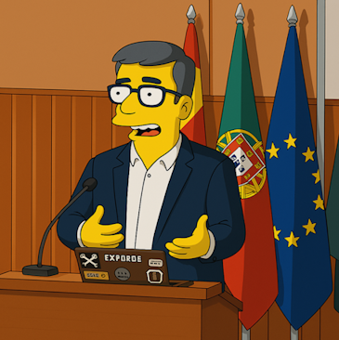
PBS
OSINT
PORTUGAL, SUN, SEA AND VULNERABILITIES
$whoami
👓 Pedro Vieira
🔐 Cybersecurity Engineer
🕵️ OSINT
✒️ Full stack developer
👨‍🏫 Public Speaker
Page 5

Slide 6
PBS
OSINT
PORTUGAL, SUN, SEA AND VULNERABILITIES
Vulnerability
Definition and Statistics
Page 6

Slide 7


PBS
OSINT
PORTUGAL, SUN, SEA AND VULNERABILITIES
Vulnerability - Vulnerability vs incident
Logged In Remote Access
"A weakness in the computational logic (e.g., code) found in software and hardware components that, when exploited, results in a negative impact to confidentiality, integrity, or availability."
National Vulnerability Database - https://nvd.nist.gov/vuln
Vulnerability | Incident
Open door
Unauthorized access
images: Flaticon.com
Page 7
Notes:
Vulnerability - Known weakness in the system that can be exploited
Incident - Exploitation of the existing vulnerability

Slide 8
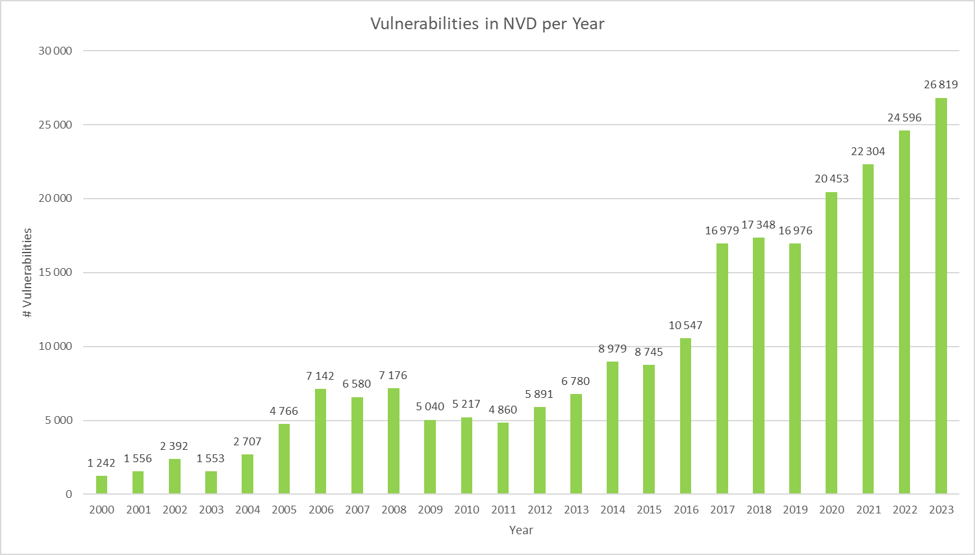
PBS
OSINT
PORTUGAL, SUN, SEA AND VULNERABILITIES
Vulnerability - Statistics by Year
Total known vulnerabilities
283.154
Source NVD 14/03/2024
Page 8

Slide 9
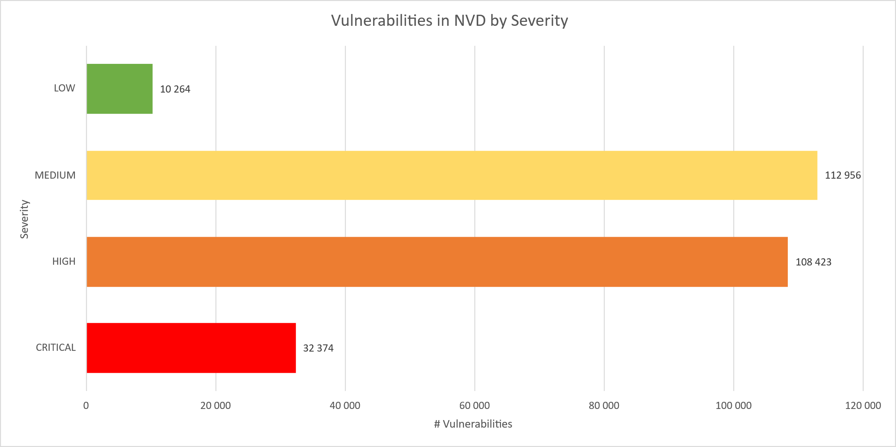
PBS
OSINT
PORTUGAL, SUN, SEA AND VULNERABILITIES
Vulnerability - Statistics by Severity
Source NVD 14/03/2024
Page 9
Notes:
High and Critical amounts to more than 53% of all vulnerabilities

Slide 10
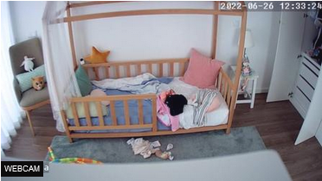
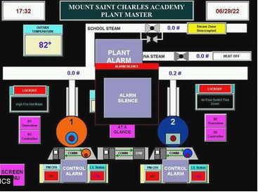
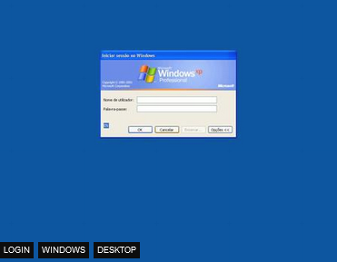
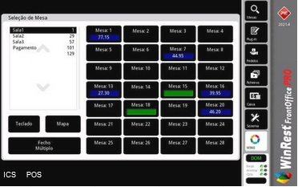
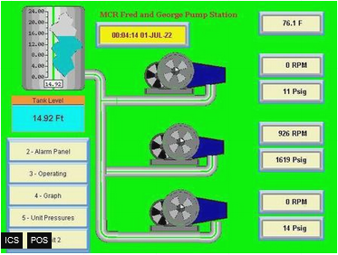
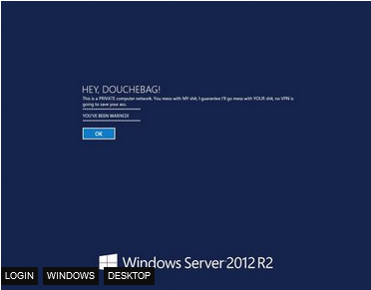
PBS
OSINT
PORTUGAL, SUN, SEA AND VULNERABILITIES
Vulnerability - Examples from Shodan.io
Default/No Password | Industrial Control Systems | Vulnerable Systems
Page 10

Slide 11
PBS
OSINT
PORTUGAL, SUN, SEA AND VULNERABILITIES
Common Attack Vectors
Easy-Peasy
Page 11

Slide 12
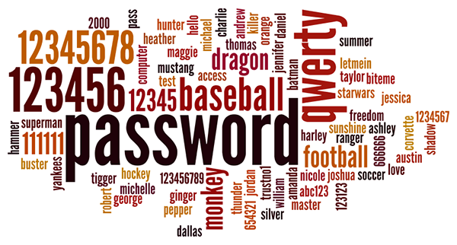
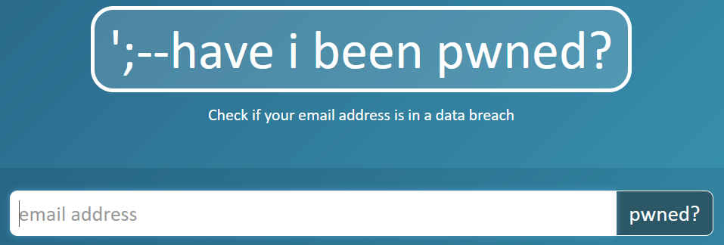
PBS
OSINT
PORTUGAL, SUN, SEA AND VULNERABILITIES
Common Attack Vectors - Credentials
Insecure | Compromised/Leaked
No password Default credentials (admin/admin) Weak passwords Reused passwords | Hacked legitime sites leaked user information and credentials Mother of all breaches reveals 26 billion records
Page 12
Notes:
rockyou.txt contains 14,341,564 unique passwords, used in 32,603,388 accounts.
https://www.troyhunt.com/the-773-million-record-collection-1-data-reach/

Slide 13
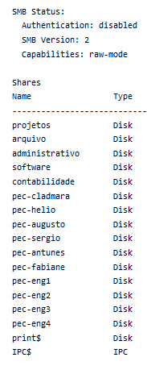
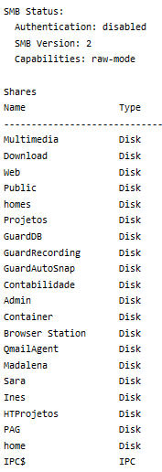
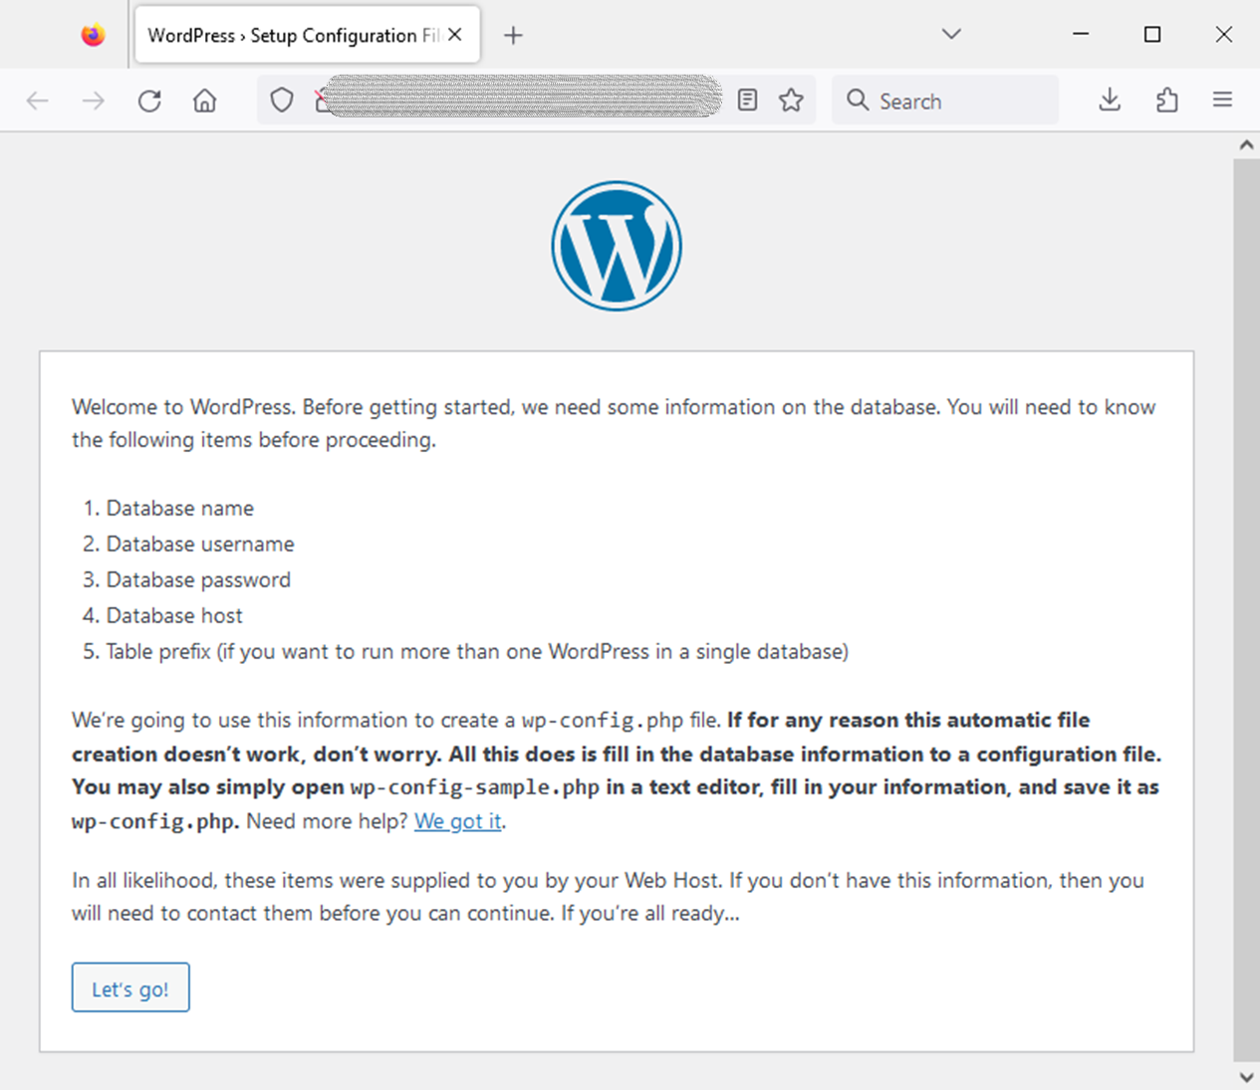
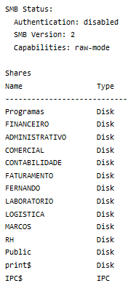
PBS
OSINT
PORTUGAL, SUN, SEA AND VULNERABILITIES
Common Attack Vectors - Misconfiguration
Shared Folder – Authentication disabled | WordPress site – Configuration available
Page 13
Notes:
https://www.shodan.io/search?query=contabilidade+port%3A445
Shared folder
Authenticated disabled
World accessible

Slide 14
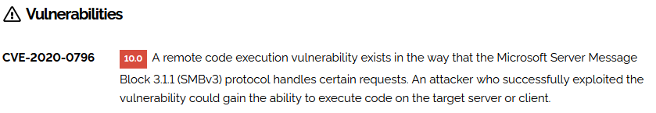

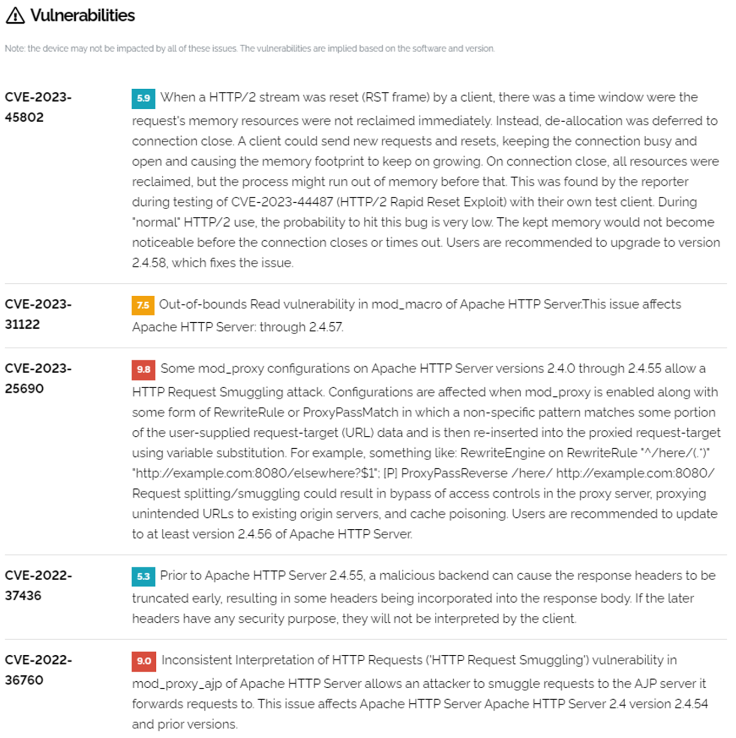
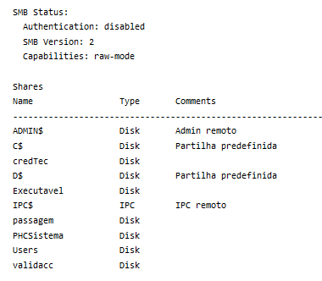
PBS
OSINT
PORTUGAL, SUN, SEA AND VULNERABILITIES
Common Attack Vectors - Software Vulnerabilities
Shared Folder - Remote Code Execution | Website – Several vulnerabilities
Page 14

Slide 15
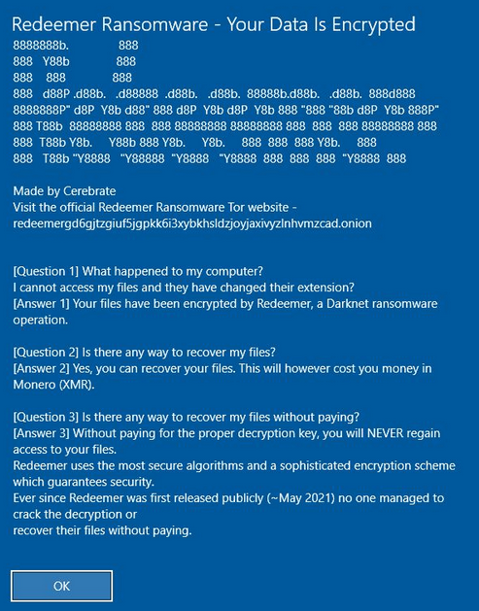
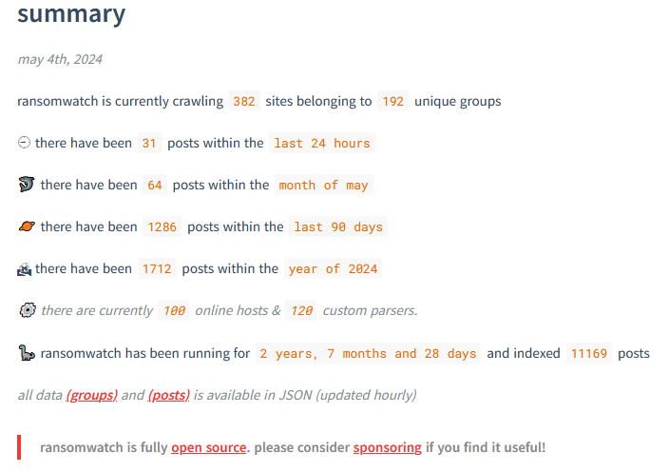
PBS
OSINT
PORTUGAL, SUN, SEA AND VULNERABILITIES
Common Attack Vectors - Malware - Ransomware
Redeemer Ransomware | Ransomwatch
Page 15
Notes:
https://images.shodan.io/?query=ransomware
https://www.nomoreransom.org/en/index.html
https://www.bleepingcomputer.com/news/security/french-hospital-chc-sv-refuses-to-pay-lockbit-extortion-demand/
https://www.darkreading.com/cyberattacks-data-breaches/hubris-may-have-caused-lockbit-s-downfall

Slide 16
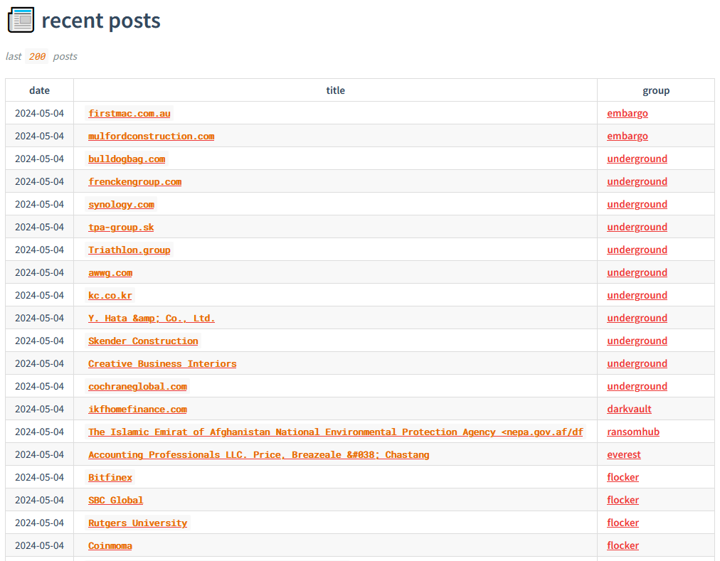
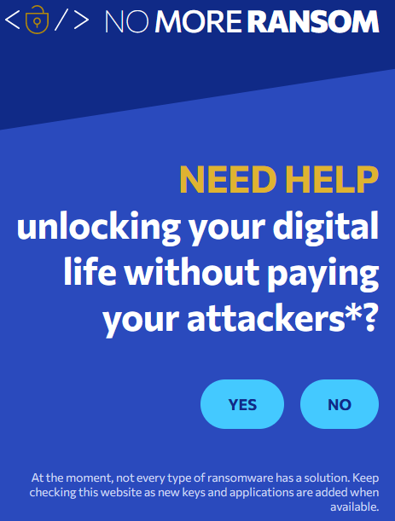
PBS
OSINT
PORTUGAL, SUN, SEA AND VULNERABILITIES
Portugal - Shodan.io - Search Engine for Internet Of Things
Ransomwatch | NoMoreRansom
Page 16
Notes:
https://ransomwatch.telemetry.ltd/#/README
https://ransomwatch.telemetry.ltd/#/recentposts

Slide 17
PBS
OSINT
PORTUGAL, SUN, SEA AND VULNERABILITIES
Portuguese landscape
Definition and Statistics
Page 17

Slide 18
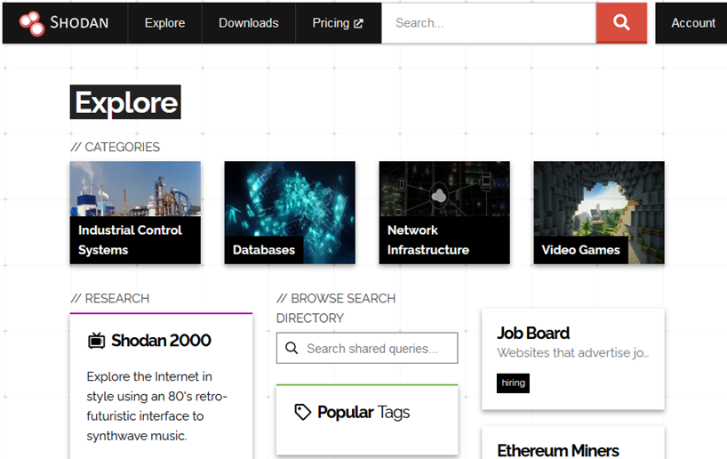
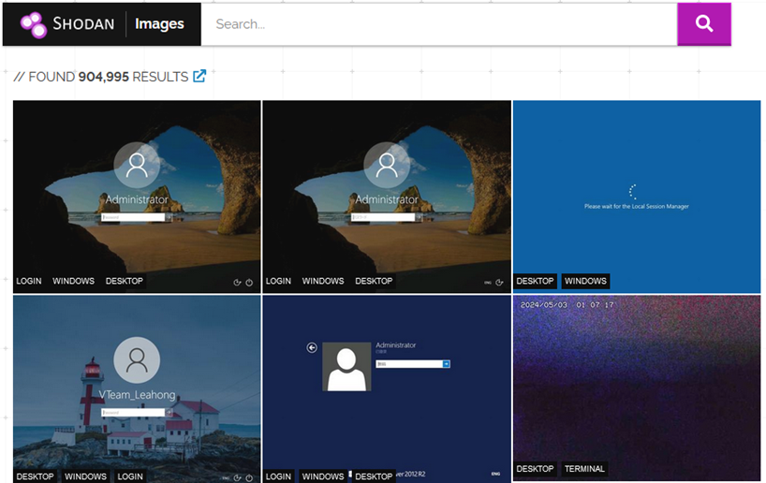
PBS
OSINT
PORTUGAL, SUN, SEA AND VULNERABILITIES
Portugal - Shodan.io - Search Engine for Internet Of Things
Explore | Images
Shodan Queries (link)
Page 18

Slide 19
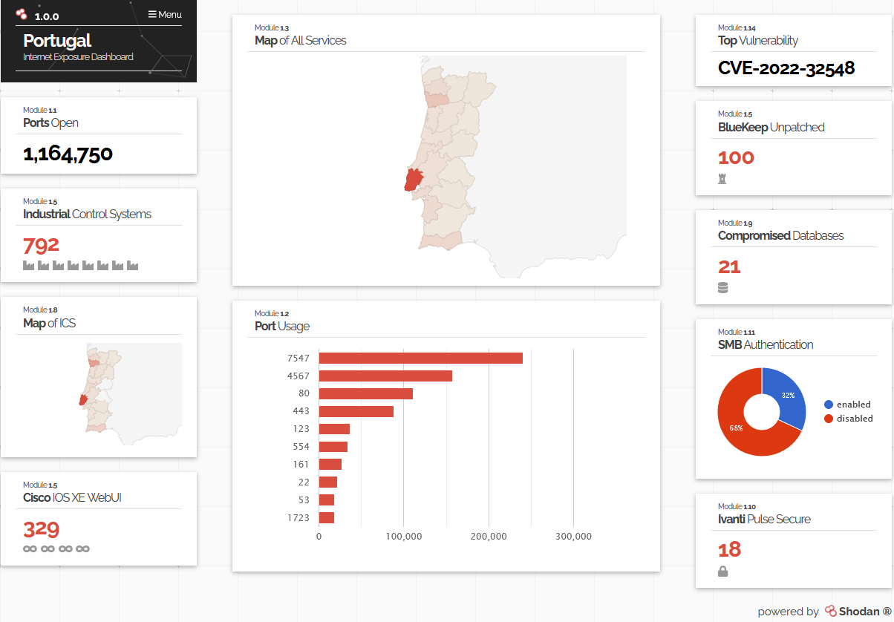
PBS
OSINT
PORTUGAL, SUN, SEA AND VULNERABILITIES
Portugal - Shodan.io - Search Engine for Internet Of Things
Internet Exposure Observatory
Page 19
Notes:
https://exposure.shodan.io/#/PT

Slide 20
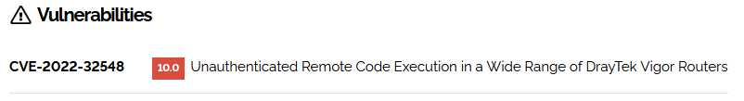
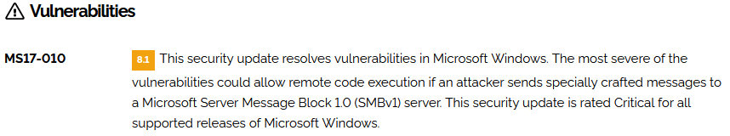
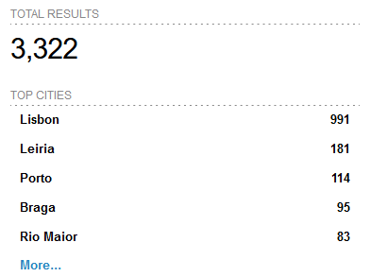
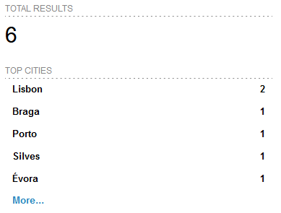
PBS
OSINT
PORTUGAL, SUN, SEA AND VULNERABILITIES
Portugal - Shodan.io - Search Engine for Internet Of Things
Top in Portugal - CVE-2022-32548 | EternalBlue - MS17-010 - CVE-2017-0144
Page 20
Notes:
https://www.shodan.io/search?query=vuln%3ACVE-2022-32548+country%3Apt
https://www.shodan.io/search?query=vuln%3Ams17-010+country%3Apt

Slide 21
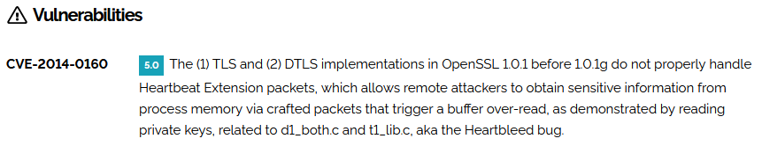
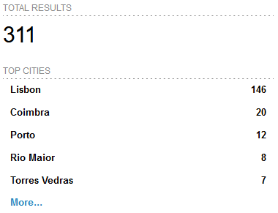
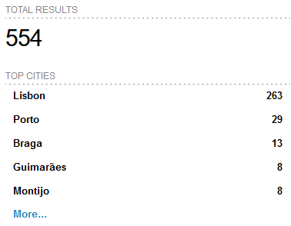
PBS
OSINT
PORTUGAL, SUN, SEA AND VULNERABILITIES
Portugal - Shodan.io - Search Engine for Internet Of Things
Heartbleed - CVE-2014-0160 | SMBGhost - CVE-2020-0796
Page 21
Notes:
https://www.shodan.io/search?query=vuln%3ACVE-2014-0160+country%3Apt
https://www.shodan.io/search?query=vuln%3ACVE-2020-0796+country%3Apt

Slide 22
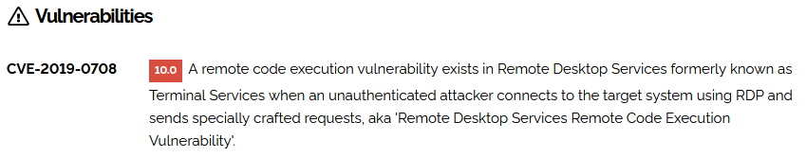
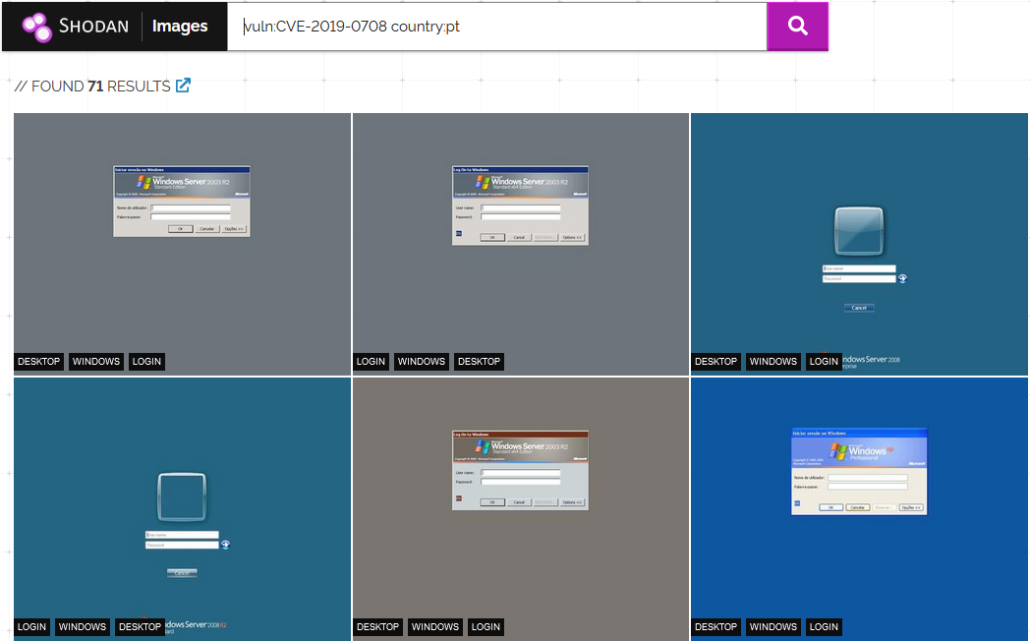
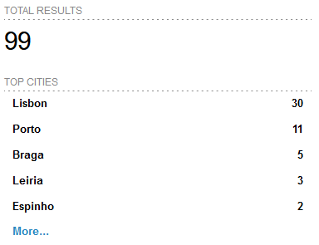
PBS
OSINT
PORTUGAL, SUN, SEA AND VULNERABILITIES
Portugal - Shodan.io - Search Engine for Internet Of Things
BlueKeep - CVE-2019-0708
Page 22
Notes:
https://www.shodan.io/search?query=vuln%3ACVE-2019-0708+country%3Apt

Slide 23
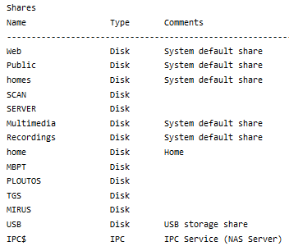
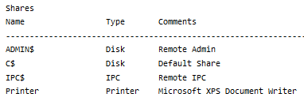
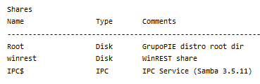
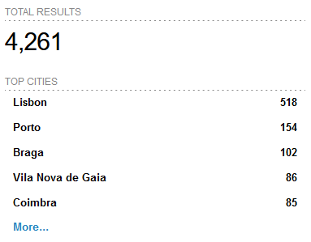
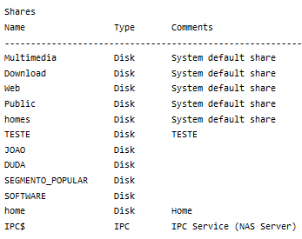
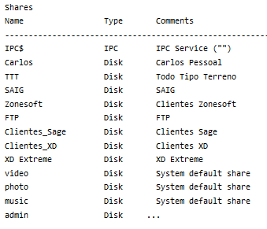
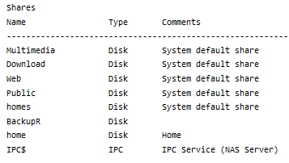
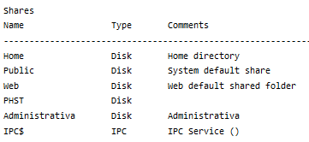
PBS
OSINT
PORTUGAL, SUN, SEA AND VULNERABILITIES
Portugal - Shodan.io - Search Engine for Internet Of Things
Shared Folders
Page 23
Notes:
https://www.shodan.io/search?query=country%3Apt+port%3A%22445%22+Authentication%3A+%22disabled%22

Slide 24
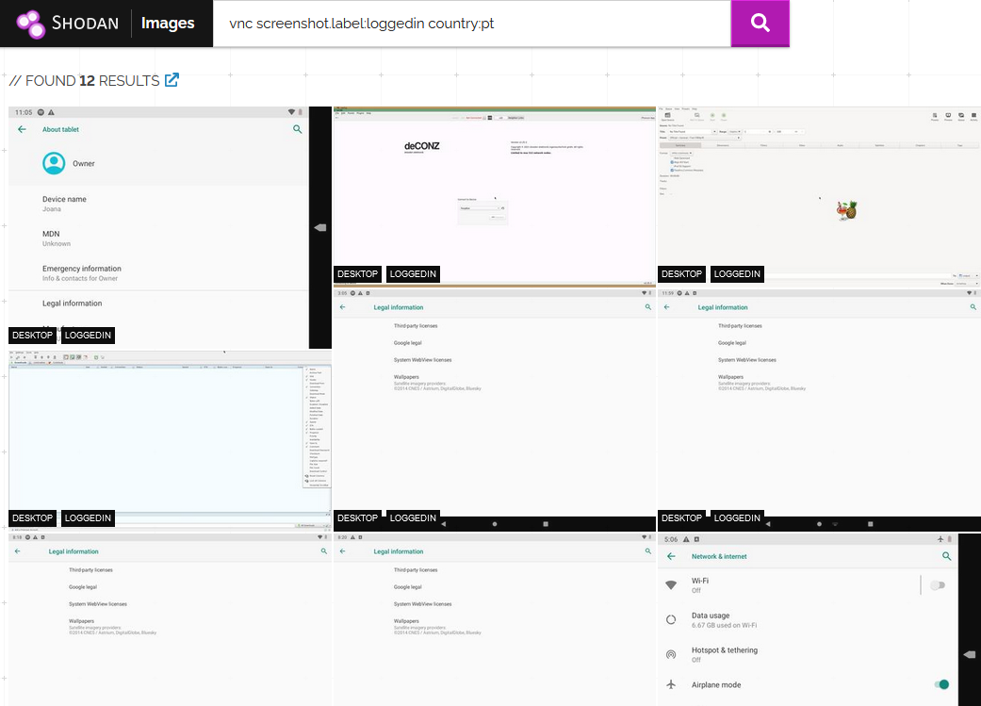
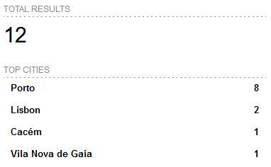
PBS
OSINT
PORTUGAL, SUN, SEA AND VULNERABILITIES
Portugal - Shodan.io - Search Engine for Internet Of Things
Page 24
Notes:
https://images.shodan.io/?query=vnc+screenshot.label%3Aloggedin+country%3Apt

Slide 25

PBS
OSINT
PORTUGAL, SUN, SEA AND VULNERABILITIES
Portugal - Shodan.io - Search Engine for Internet Of Things
Webcam
Page 25
Notes:
https://images.shodan.io/?query=has_screenshot%3Atrue+country%3A%22DE%22+-screenshot.label%3Adesktop&language=en

Slide 26

PBS
OSINT
PORTUGAL, SUN, SEA AND VULNERABILITIES
THANK YOU
Q & A
Page 26

